Slide 1
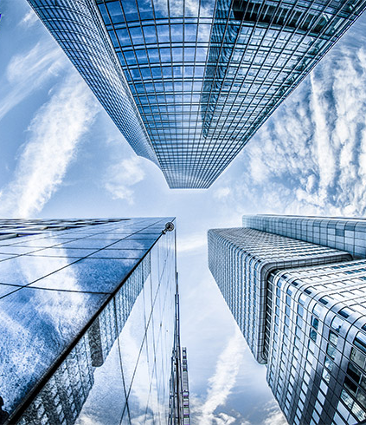

BUILDING A RECOMMENDATION ENGINE
Project Team:
Gilat Mandelbaum
Harshinder Singh Kohli
Sakina Presswala
Phuong Le

Slide 2
PROJECT OVERVIEW
* “Content based Filtering” - Similarity of items is determined by measuring the similarity in their properties
Objective
To build a recommendation system for recommending events based on “Content based Filtering”* approach and design a simple web application to visualize the output.
5 Phases:
Pipeline
Display
Enrichment
Analysis
Iteration
Tools Used :
Amazon Web Services(AWS) - Glue, S3, Lambda, Athena
Python - Pandas, Numpy, Scikit learn, Scipy

Slide 3
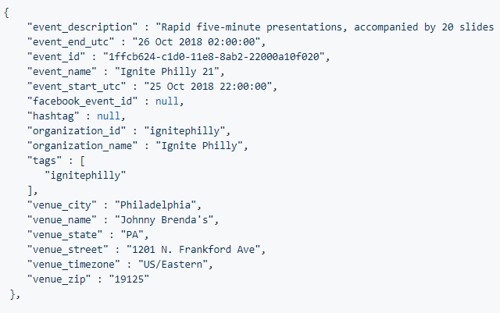
DATA
Event Data - 81,494 events and 16 attributes extracted from TicketLeap using their public event API.
DMA (Designated Market Area) Data - Data containing DMAs, County, State and Zip Codes as of 2016
(Courtesy: Geographic Information on Designated Media Markets archive in the Harvard Dataverse)

Slide 4
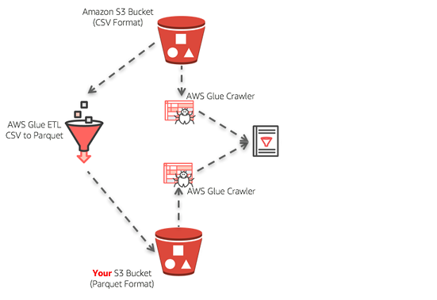
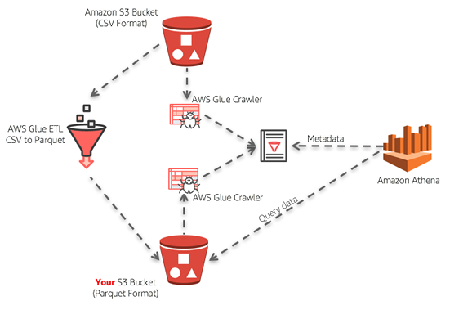
PHASE 1: PIPELINE
Task In Hand
A transformation pipeline that cleans and normalizes incoming data.
Transformations must include:
Converting all dates to ISO 8601 UTC datetime format (YYYY-mm-ddTHH:MM:SSZ).*
Normalizing the data to remove extraneous characters (embedded newlines, non-renderable UTF-8 symbols, etc).
A diagram (exported as a png) representing your pipeline and its components.

Slide 5
PHASE 1: PIPELINE
What we did
Uploaded data files to S3 Created a AWS Glue crawler to read the events json file from S3 and converted it to csv format
Created a Glue job to transform csv data to parquet files which was stored in S3
Modified the proposed PySpark script generated by AWS Glue to change dates to ISO 8601 UTC datetime format (YYYY-mm-ddTHH:MM:SSZ) and remove extraneous characters from “event name” and “event description”
Viewed the cleaned data using Athena

Slide 6
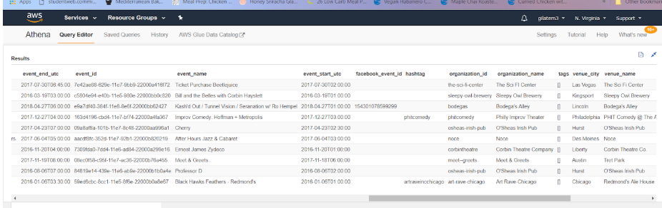
PHASE 1: PIPELINE
Final output from Phase 1 - as viewed in Athena

Slide 7
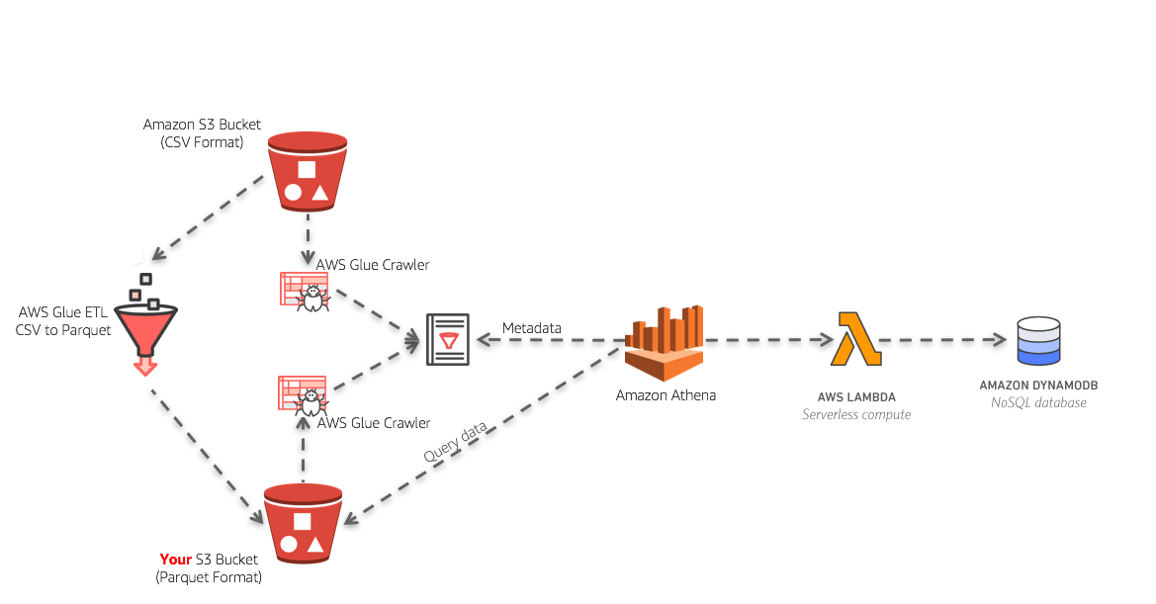
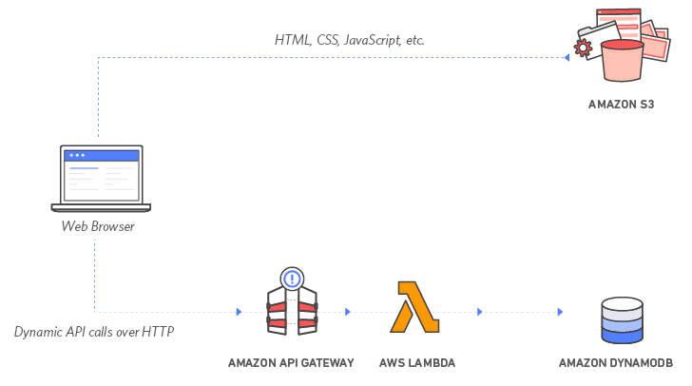
PHASE 2 : DISPLAY
Task In Hand
A display pipeline that takes the output of the Phase 1 transformations and loads them into a datastore.
A web-based display that can query the data-store and display results for a single, known event id.
A diagram (exported as a png) representing your ecosystem, including Phase 1.

Slide 8
PHASE 2: PIPELINE
What we did
Challenges
PART 1:
Create Lambda function that access Athena, with an SQL query that takes the data created in Phase 1 & 3 and uploads it into a DynamoDB table.
PART 2:
Set up serverless host, displaying index.html
Use API Gateway to query data by a provided event_id from the DynamoDB table.
Use JavaScript code to loop through recommendation list, which includes associated event_ids, and query their data from DynamoDB.
PART 1:
Figuring out how to trigger the initial Lambda function: We used uploading a file to an S3 bucket.
Credits quickly depleting when all event data was stored in S3: Limited the amount of data we stored.

Slide 9
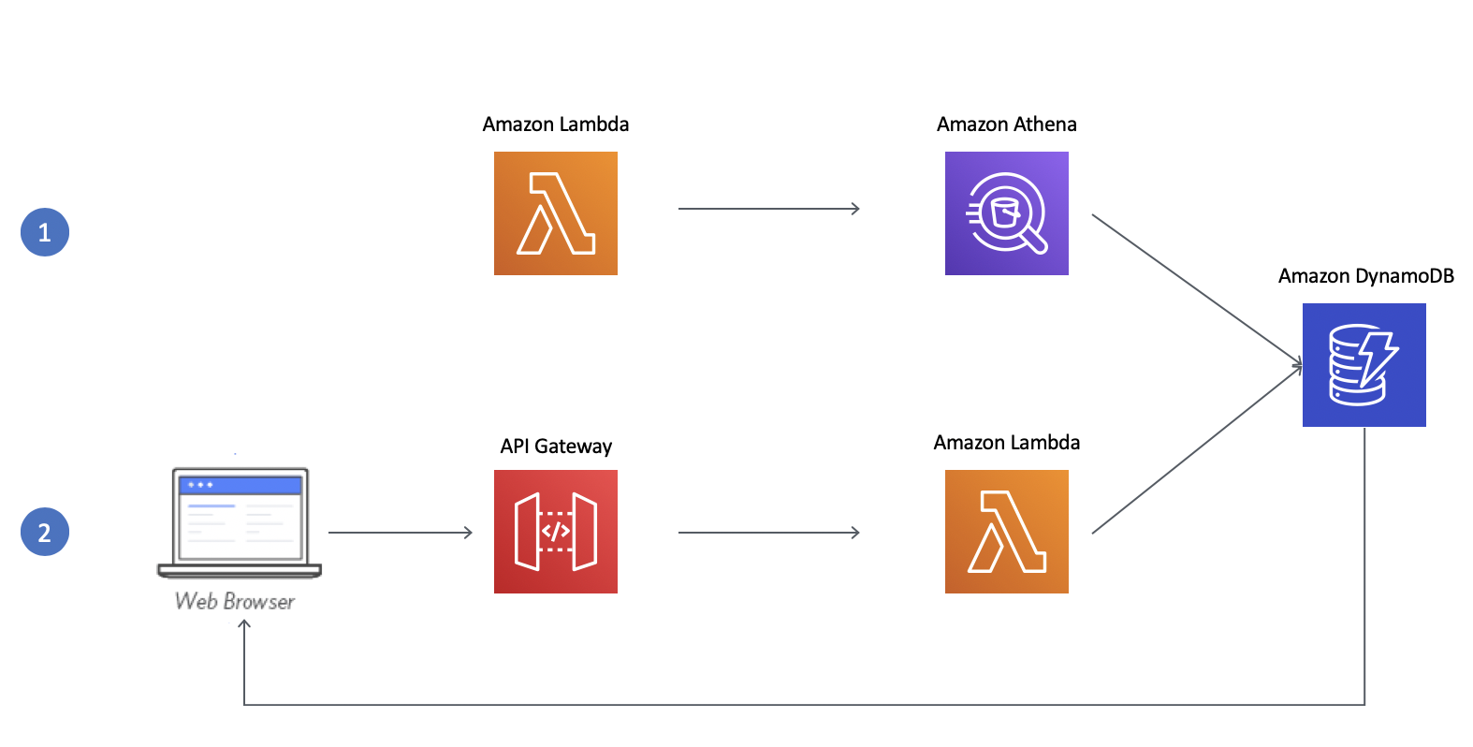
PHASE 2: DISPLAY

Slide 10
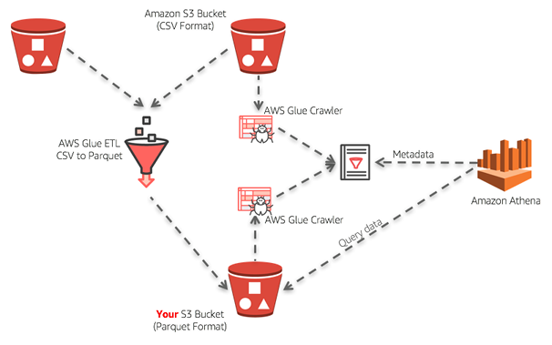
PHASE 3 : ENRICHMENT
Task In Hand
A transformation pipeline that merges DMA-zip.csv.gz data with events.json.gz.
Display of the event's DMA name in your web application.
A diagram (exported as a png) representing your ecosystem, including Phase 2.
A (merged and closed) pull request from your feature branch (phase_3) to your master that covers all your code, utilities, notes, and so on.

Slide 11
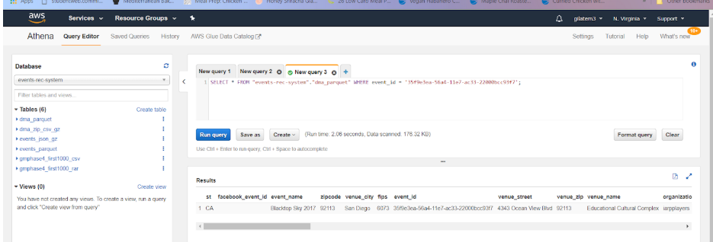
PHASE 3 : ENRICHMENT
What we did
Merged DMA data to the Events data by modifying and adding code to the PySpark script / job from phase 1.
Ran the glue crawler to get the new table containing the combined data .
Created a diagram to demonstrate our work in phase 2 & 3

Slide 12
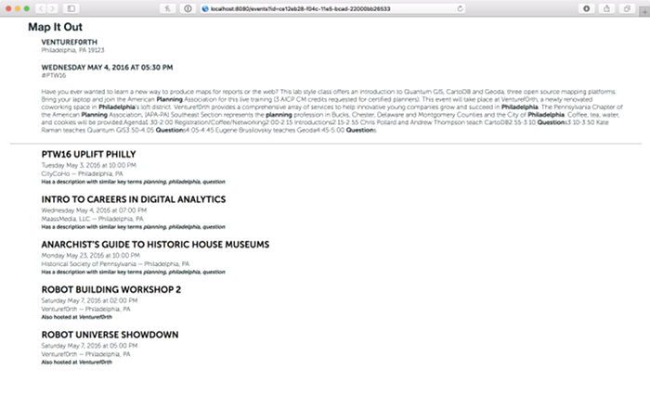
PHASE 4 : ANALYSIS
Task In Hand
A transformation pipeline that creates event recommendations based on at least one algorithm.
Display of recommendations on the web page alongside the requested event. The display must include
At least 5 recommended events in the same geographic area
The event name, description, venue name and address (for visual human "relevance scoring")
The reason for the recommendation, such as "Based on events in a similar location" or "Based on events with wine in their name"
A diagram (exported as a png) representing your ecosystem, including Phase 3.
A (merged and closed) pull request from your feature branch (phase_4) to your master that covers all your code, utilities, notes, and so on.

Slide 13
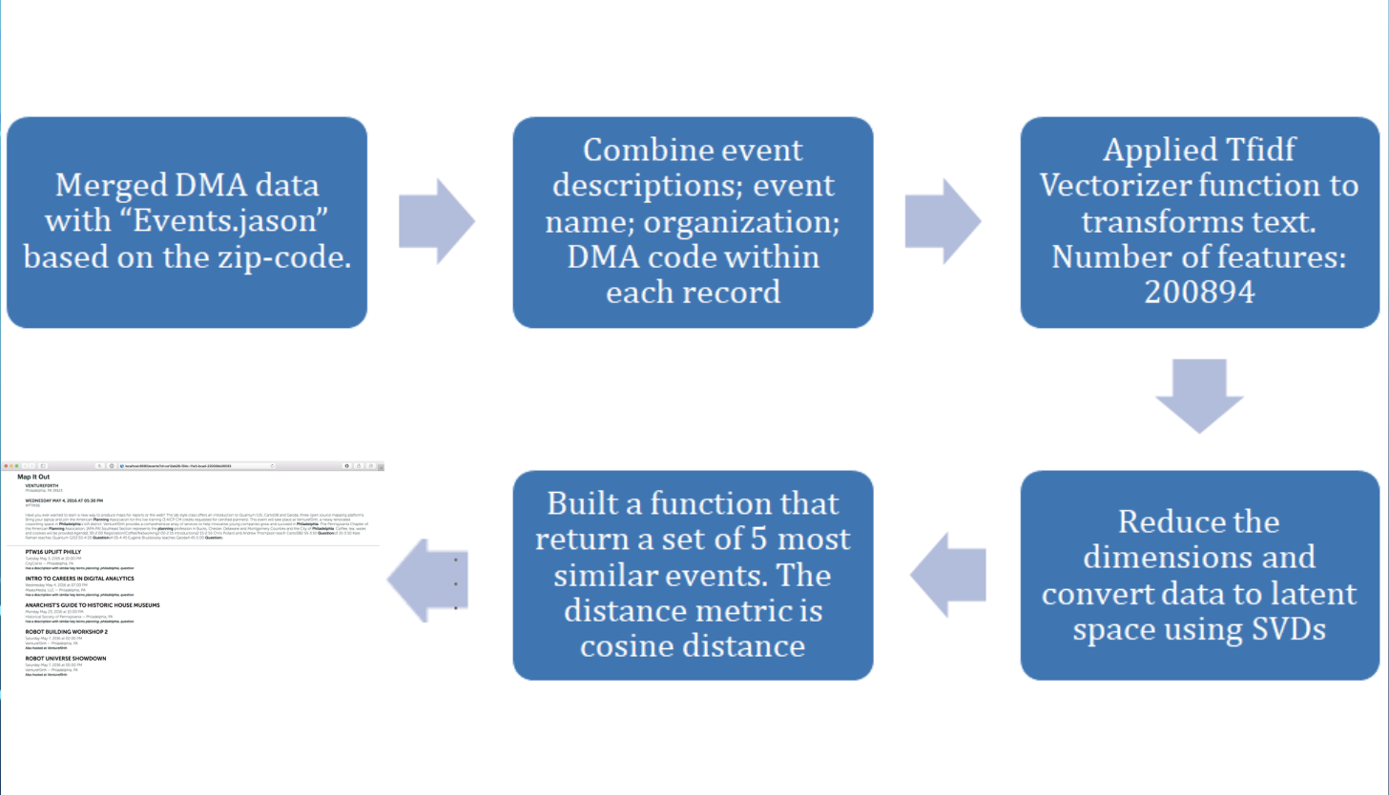
PHASE 4 : ANALYSIS

Slide 14
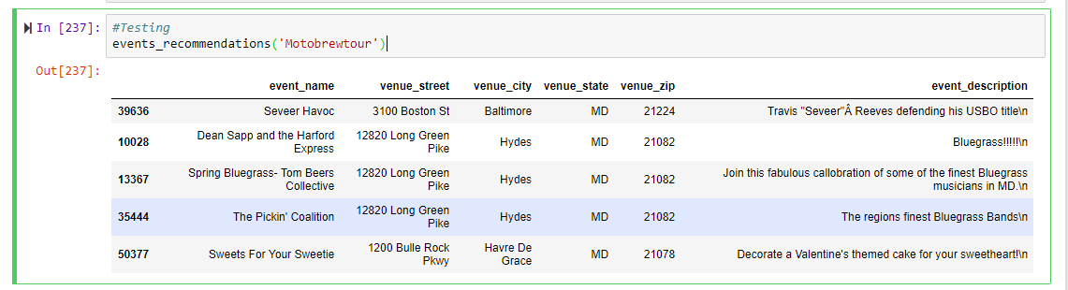
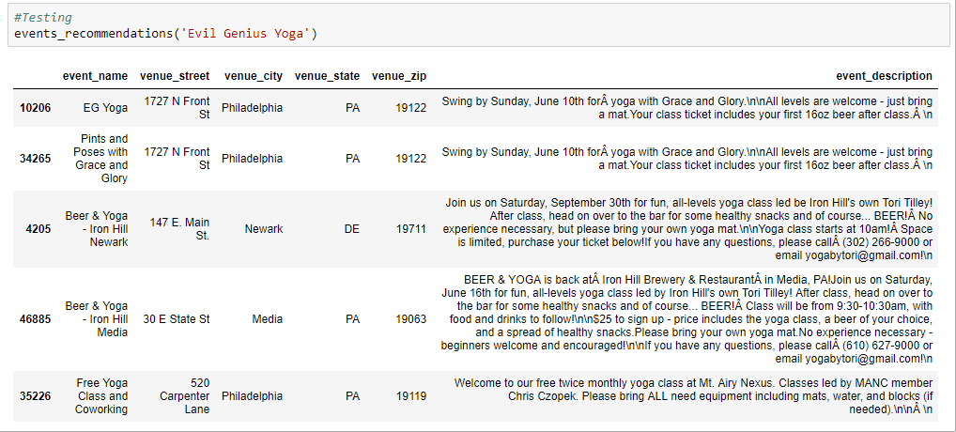

Slide 15
PHASE 5: ITERATION
Task In Hand
A transformation pipeline that creates event recommendations based on at least one additional enriched data set.
A diagram (exported as a png) representing your entire ecosystem.
A (merged and closed) pull request from your feature branch (phase_5) to your master that covers all your code, utilities, notes, and so on.

Slide 16
PHASE 5: ITERATION
What we did
We tried implementing date logic to filter out the events that had already passed but haven’t succeeded yet.
Future work
Improve our recommendation engine by trying out different ML algorithms such as clustering, KNN and Neural Networks
Use other approaches such as “Collaborative filtering” and “Hybrid filtering” based on availability of data.

Slide 17

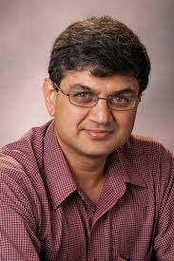
ACKNOWLEDGEMENTS
Mr. Geoffrey Young
Vice President, Engineering - IntegriChain
Prof. Sunil Shende Associate Professor & Graduate Director of the Department of Computer Science Rutgers University,
New Jersey

